Slide 1
Outline
Review: Switch Model for TTL-based Solution
Problems Caused by The TTL-based Solution
PFC Headroom is Too Large
Per Flow Fairness Will be Violated

Slide 2
Outline
Review: Switch Model for TTL-based Solution
Problems Caused by The TTL-based Solution
PFC Headroom is Too Large
Per Flow Fairness Will be Violated

Slide 3
Review: Switch Model
The switch model consists of five elements: switch port, forwarding engine, PFC engine, crossbar and switch buffer.

Slide 4
Outline
Review: Switch Model for TTL-based Solution
Problems Caused by The TTL-based Solution
PFC Headroom is Too Large
Per Flow Fairness Will be Violated

Slide 5
Calculation of PFC Headroom
The time to send a PAUSE message at the receiver side (denoted as t_{snd}): in the worst case, the receiver generates a PAUSE frame right when the first bit of a maximum-size packet.
t_{snd}= (s_{MTU} + s_{PFC})/r_{l}
Sender
Receiver

Slide 6
Calculation of PFC Headroom
2. The time for the PAUSE message to propagate from the receiver to the sender over the network link (de- noted as t_{wire}): the value of t_{wire} is related to the materia and the length of the network links in use.
Sender
Receiver

Slide 7
Calculation of PFC Headroom
3. The time to receive a PAUSE message at the sender side(denoted as t_{rev}).
t_{rev}= s_{PFC}/r_{l}
Sender
Receiver

Slide 8
Calculation of PFC Headroom
4. The time to process a PAUSE message at the sender side
(denoted as t_{pro}): the value of t_{pro} is implementation-dependent.
Sender
Receiver

Slide 9
Calculation of PFC Headroom
5. The time to stop packet transmission at the sender side (denoted as t_{stop}): In the worst case, the sender will have completed the pro- cess of the PAUSE message just when the first bit of a maximum-size packet has started engaging the packet transmission.
t_{stop}= s_{MTU}/r_{l}
Sender
Receiver

Slide 10
Calculation of PFC Headroom
6. The time for the remaining bytes of packets on the link to get drained after stopping packet transmission at the sender (also denoted as t_{wire}): This part of time is equal to the time for the PAUSE message to propagate from the receiver to the sender.
Sender
Receiver

Slide 11
Calculation of PFC Headroom
In summary, the per port per priority PFC headroom b_{hr} can be expressed using the following equation:
b_{hr} = r_{l} (t_{snd} +t_{wire} +t_{rev} +t_{pro} +t_{stop} +t_{wire})
= 2(s_{MTU} +s_{PFC} +r_{l} t_{wire})+r_{l} t_{pro}

Slide 12
Calculation of PFC Headroom
For typical TCP/IP based RDMA DCNs, we have s_{MTU} = 1500bytes, s_{PFC} = 64bytes.
Every 100 meters of link delays the reception of a packet by about 500ns for copper cables. The length of links used in a single DCN is usually no larger than 300 meters. Hence we have t_{wire} ≤ 1.5us.
Let a quanta be the time needed to transmit 512 bits at the current network speed. The PFC definition caps this time to 60 quanta for any implementation. Hence we have r_{l} ∗ t_{pro} = 512 ∗ 60 = 30, 720 bits.

Slide 13
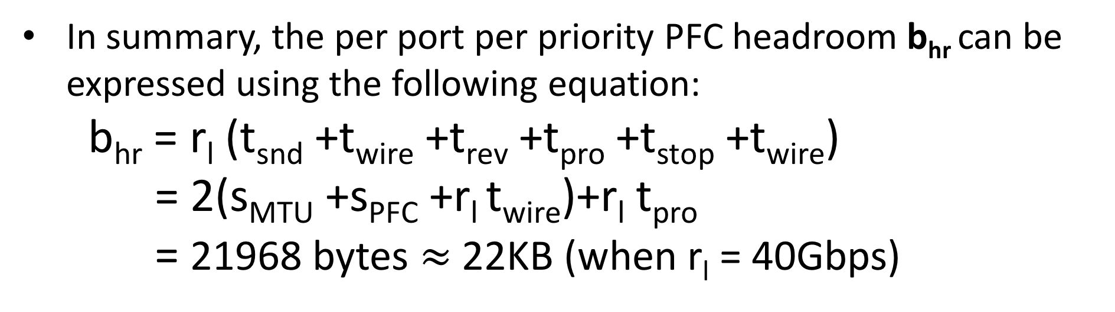
Calculation of PFC Headroom
In summary, the per port per priority PFC headroom b_{hr} can be expressed using the following equation:
b_{hr} = r_{l} (t_{snd} +t_{wire} +t_{rev} +t_{pro} +t_{stop} +t_{wire})
= 2(s_{MTU} +s_{PFC} +r_{l} t_{wire})+r_{l} t_{pro}
= 21968 bytes $≈$ 22KB (when r_{l} = 40Gbps)

Slide 14
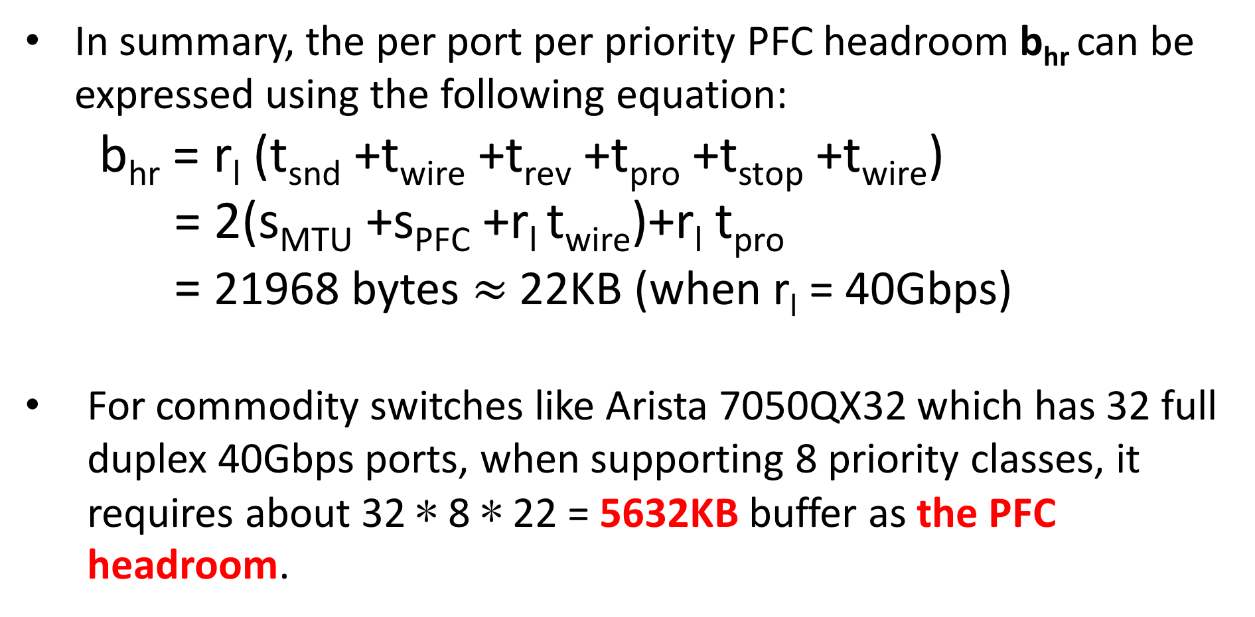
Calculation of PFC Headroom
In summary, the per port per priority PFC headroom b_{hr} can be expressed using the following equation:
b_{hr} = r_{l} (t_{snd} +t_{wire} +t_{rev} +t_{pro} +t_{stop} +t_{wire})
= 2(s_{MTU} +s_{PFC} +r_{l} t_{wire})+r_{l} t_{pro}
= 21968 bytes $≈$ 22KB (when r_{l} = 40Gbps)
For commodity switches like Arista 7050QX32 which has 32 full duplex 40Gbps ports, when supporting 8 priority classes, it requires about 32 ∗ 8 ∗ 22 = 5632KB buffer as the PFC headroom.

Slide 15
Reducing Number of Priorities Needed by The TTL-based Solution
…
…
…
…
Assuming at all source servers, initial TTL value of all packets are set to ttl₀ (a even number).

Slide 16
Reducing Number of Priorities Needed by The TTL-based Solution
TTL = ttl₀-3-2k,
odd
TTL = ttl₀-2-2k,
even
TTL = ttl₀-1-2k,
odd
TTL = ttl₀-2k,
even
…
…
…
…
Assuming at all source servers, initial TTL value of all packets are set to ttl₀ (a even number).

Slide 17
Reducing Number of Priorities Needed by The TTL-based Solution
TTL = ttl₀-3-2k,
odd
TTL = ttl₀-2-2k,
even
TTL = ttl₀-1-2k,
odd
TTL = ttl₀-2k,
even
…
…
…
…
Observation: switches at the same layer only need to support either all the even priority or all the odd priority.

Slide 18
Reducing Number of Priorities Needed by The TTL-based Solution
Priority: 1 3 5
Priority: 2 4 6
Priority: 1 3 5 7
Priority: 0 2 4 6 8
…
…
…
…
For Arista 7050QX32 switch, the PFC headroom can be reduced to a half = 32 ∗ 4 ∗ 22 = 2816KB, 23% of 12MB buffer.

Slide 19
Per Flow Fairness Under TTL-based Solution
B
f3
f1
f2
…
…
…
…
H1
H2
H3
H4
Three flows f1, f2 and f3 are from hosts H2, H3 and H4 to H1, respectively.

Slide 20
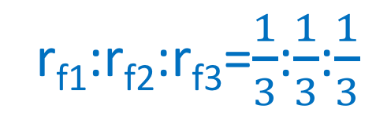
Per Flow Fairness Under TTL-based Solution
B
f3
r_{f1}:r_{f2}:r_{f3}=$\frac{1}{3}$:$\frac{1}{3}$:$\frac{1}{3}$
f1
f2
…
…
…
…
H1
H2
H3
H4
Without applying the TTL-based solution, there is only one queue. Ideally, each flow should share 1/3 bandwidth at the bottleneck link.

Slide 21
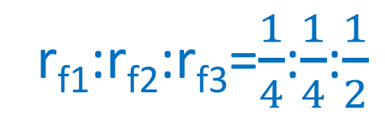
Per Flow Fairness Under TTL-based Solution
B
f3
r_{f1}:r_{f2}:r_{f3}=$\frac{1}{4}$:$\frac{1}{4}$:$\frac{1}{2}$
f1
f2
…
…
…
…
H1
H2
H3
H4
With the TTL-based solution, f1 and f2 will share a common queue, while f3 will enter a different queue. This introduces flow unfairness among three flows.

